Slide 1
Cafeteria Token System & Queue ADT
CSA0310 - Data Structures
Shree Thilak Muthukrishna
192572046

Slide 2
Problem Context & Problem Statement
High-traffic cafeteria environment with multiple customer arrivals.
Core Challenges:
Preventing line-jumping and order disputes.
Maintaining predictable waiting times for customers.
Systematizing the order processing sequence without manual bias.
Key Objective: Identify a data structure that guarantees absolute equity in customer service order.

Slide 3
Identification of Suitable ADT
Selected Data Structure: Queue Abstract Data Type (ADT)
Governing Principle: First-In, First-Out (FIFO)
Core Definition: A linear collection where elements are added strictly at one end (Rear) and removed strictly from the opposite end (Front).
Direct Real-World Analogy: Token issuance matches the Rear insertion; order collection matches Front removal.

Slide 4
Key Structural Properties of Queue ADT
Linear Sequence: Maintains a strict 1D physical or logical ordering of elements based on time of entry.
Dual Pointer Architecture:
Front Pointer: Points to the customer token currently eligible for service.
Rear Pointer: Points to the location where the next arriving token will be appended.
Restricted Access: Access to middle elements is strictly disallowed, preserving order integrity.

Slide 5
Core Operations & Time Complexity
Enqueue(token): Adds a new customer token to the Rear. Time Complexity: O(1)
Dequeue(): Removes and serves the token at the Front. Time Complexity: O(1)
Peek() / Front(): Returns the token currently at the counter without removing it. Time Complexity: O(1)
isEmpty() / isFull(): Helper operations to verify queue capacity states. Time Complexity: O(1)

Slide 6
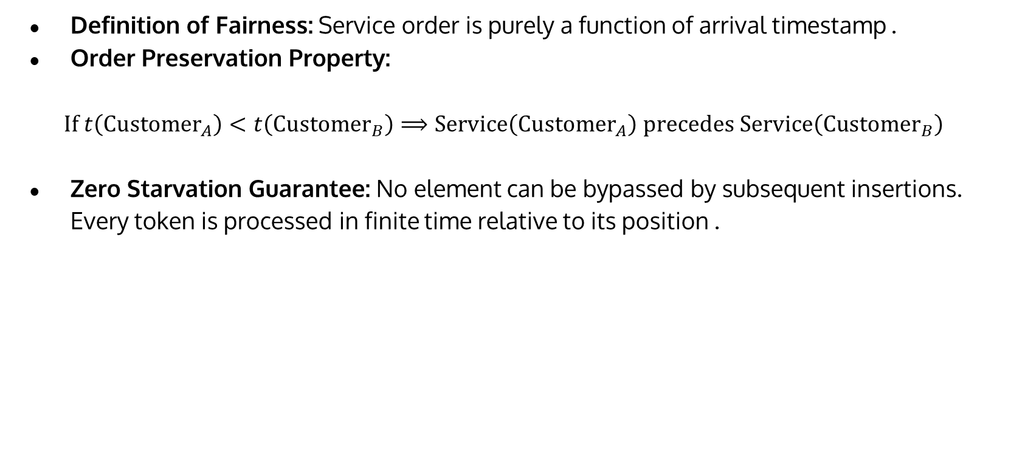
Mathematical & Algorithmic Justification of Fairness
Definition of Fairness: Service order is purely a function of arrival timestamp .
Order Preservation Property:
$$\text{If} t\left({\text{Customer}}_{A}\right)<t\left({\text{Customer}}_{B}\right)⟹\text{Service}\left({\text{Customer}}_{A}\right) \text{precedes} \text{Service}\left({\text{Customer}}_{B}\right)$$
Zero Starvation Guarantee: No element can be bypassed by subsequent insertions. Every token is processed in finite time relative to its position .

Slide 7
Why Alternative Data Structures Fail
Stack ADT (LIFO):
Last customer to arrive is served first.
Leads to severe starvation for early arrivals; totally unacceptable for service systems.
Priority Queue:
Serves higher priority first; causes low-priority customers to wait indefinitely.
Not suitable when all customers have equal service rights.
Unsorted Array/List:
Random access allows arbitrary processing, leading to human bias or linear lookup overhead.

Slide 8
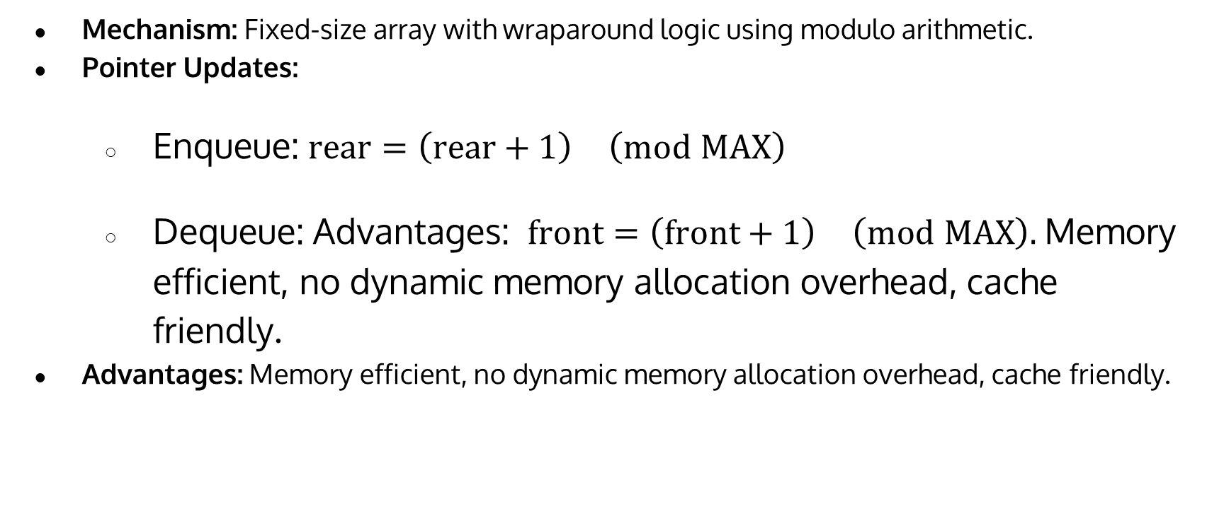
Implementation Strategy 1 - Circular Array
Mechanism: Fixed-size array with wraparound logic using modulo arithmetic.
Pointer Updates:
Enqueue: $\text{rear}=\left(\text{rear}+1\right) \left(mod \text{MAX}\right)$
Dequeue: Advantages: $\text{front}=\left(\text{front}+1\right) \left(mod \text{MAX}\right).$Memory efficient, no dynamic memory allocation overhead, cache friendly.
Advantages: Memory efficient, no dynamic memory allocation overhead, cache friendly.

Slide 9
Implementation Strategy 2 - Singly Linked List Mechanism
Dynamic node allocation using pointers. Pointer Roles:
Head pointer tracks Front (Dequeue happens at Head in ).
Tail pointer tracks Rear (Enqueue happens at Tail in ). Advantages: Dynamic capacity (no fixed size limit), no memory wastage from unused pre-allocated slots.

Slide 10
Lifecycle of a Cafeteria Token (Step-by-Step)
Arrival: Customer arrives at kiosk Kiosk calls Enqueue().
Buffer: Token advances towards the front as prior tokens dequeue.
Counter Call: Counter display calls Peek() to display the active token number.
Completion: Food served System executes Dequeue(), moving Front to .

